Slide 1
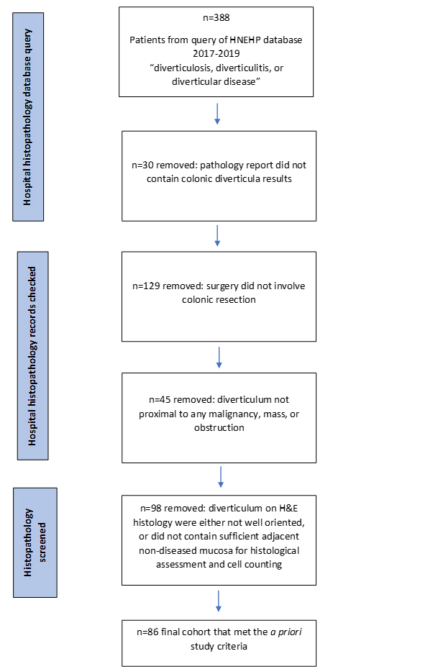
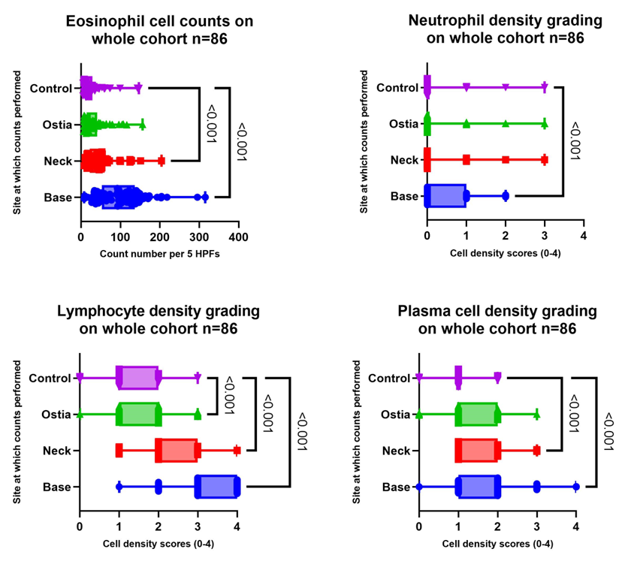
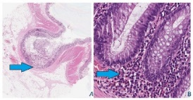
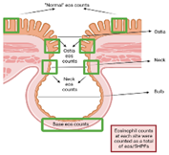
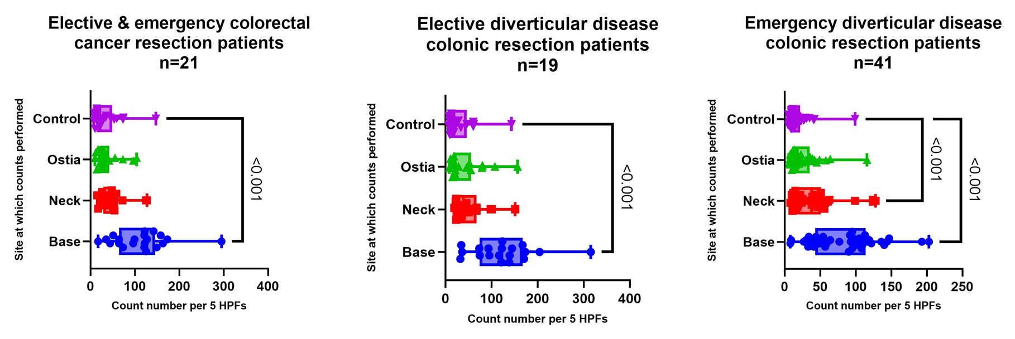
EOSINOPHILS IN COLONIC DIVERTICULAR DISEASE
Copyright © 2022 Raquel Cameron Raquel.cameron@uon.edu.au
R. Cameron ^{1,2,3} , M.M. Walker ²⁻³, M.P. Jones ^{2,4,} S. King² , S. Keely ^{1,2,3}, P. Pockney ^{2,3}, N.J. Talley ^{1,2,3} 1. University of Newcastle, College of Health, Medicine and Wellbeing, New Lambton Heights, Australia, 2. NHMRC Centre for Research Excellence in Digestive Health, Newcastle, Australia 3. Hunter Medical Research Institute, Newcastle, Australia, 4. Macquarie University, Psychology, North Ryde, Australia
Colonic diverticula are herniations of the mucosa and muscularis[1]. The pathoaetiology of diverticula is unclear.
Diverticulosis is asymptomatic in the majority of individuals and is considered to be a non-inflammatory process[2].
However, in 4% of patients, acute inflammation leads to diverticulitis[1], heralded by an infiltrate of neutrophils.
In chronic or complicated diverticulitis, there is a preponderance of lymphocytes, and plasma cells[3]. Eosinophils may induce colonic damage[1] but in diverticular disease (DD), a quantitative assessment of eosinophil numbers has not been evaluated.
We aimed to investigate if eosinophils are increased in the base, neck and ostia of colonic diverticula (Figures 1&2).
As per the flowchart (Figure 3), 86 colonic resection histological samples were selected to count eosinophils in the of a diverticulum, as well as control tissue (defined as non-diseased luminal mucosa from the same patient). The eosinophil count was performed at x40 resolution in five high power fields (HPFs), each within a grid of 200um. Normal was defined a priori as <25 in any single HPF as per the diagnostic criteria for eosinophilic colitis and colonic eosinophilia[4]. Data analysis contrasts were made using linear mixed models accounting for within-subject correlation due to repeated measurement across diverticulum sites. Analyses were conducted first for the overall cohort Figure 4 and then stratified for the subgroups CRC, elective DD, and emergency DD. Figure 5 Neutrophils, plasma cells, and lymphocytes were graded for cell density. Figure 4
The analysis for the entire cohort showed statistically significant increased eosinophils in the base (P<0.001) and neck (P<0.001) when compared with the control location for the cohort combined. Figure 4 The ostia was not significant compared to controls. Figure 5
When stratifying the analysis for the subgroups, eosinophils were also significant in the base (P<0.001)) for CRC (n=21; age mean 76.76 (65-95)); 13 males/8 females); and elective DD (n=19; age mean 64.89 (42-67); 8 males/11 females). The neck and ostia was not significant compared to the control site. Emergency DD was statistically significant in both the base and neck of the diverticulum bulb. (n=41; age mean 63.66 (23-91); 21 males/20 females). Again, the ostia was not significant.
In diverticular disease, there is a significant eosinophil driven inflammatory response at the base and neck (in the entire cohort and emergency DD resection) of the diverticulum. This may indicate that subtle eosinophilic colitis plays a role in the formation of the diverticulum and may play a role in disease progression. Further work to confirm eosinophil and immune activation in diverticulosis are in progress.
References:
1. Walker, M.M. and A.K. Harris, Pathogenesis of diverticulosis and diverticular disease. Minerva Gastroenterol Dietol, 2017. 63(2): p. 99-109.
2. Jarbrink-Sehgal, M.E., et al., Diverticulosis, Symptoms and Colonic Inflammation: A Population-Based Colonoscopy Study. Am J Gastroenterol, 2019. 114(3): p. 500-510.
3. Tursi, A., et al., Assessment and grading of mucosal inflammation in colonic diverticular disease. J Clin Gastroenterol, 2008. 42(6): p. 699-703.
4. Turner, K.O., et al., Primary Colonic Eosinophilia and Eosinophilic Colitis in Adults. Am J Surg Pathol, 2017. 41(2): p. 225- 233.
Introduction::
Results::
Aims:
Figures: 1. Diverticulum observed by Aperio ImageScope.
H&E resection tissue sample from the sigmoid colon. (A: 25x; B: 40x mag.)
Figure 2: Illustration by Biorender.com showing regions of
diverticulum counted for eosinophils.
Conclusions::
.
Figure 3. Flowchart showing the cohort selection process.
Figure 4. Box and violin graphs for eosinophil counts for the entire cohort (n=86) at the diverticulum base, neck, and ostia vs the control site. Also, cell density grading graphs for neutrophils, plasma cells, and lymphocytes.
Methods::
:
Figure 5. Box and violin graph for eosinophil counts for subgroups CRC vs elective DD vs emergency DD at the diverticulum base, neck, and ostia vs. the control site.
All authors have declared no conflict of interest

